Slide 1
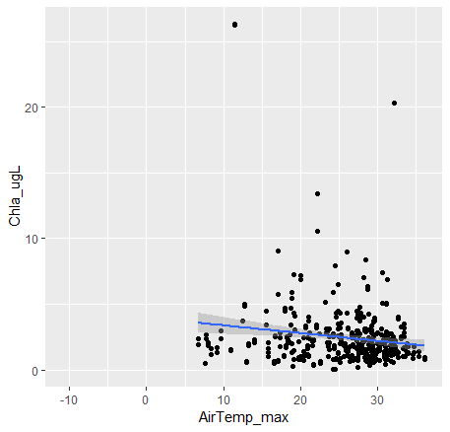
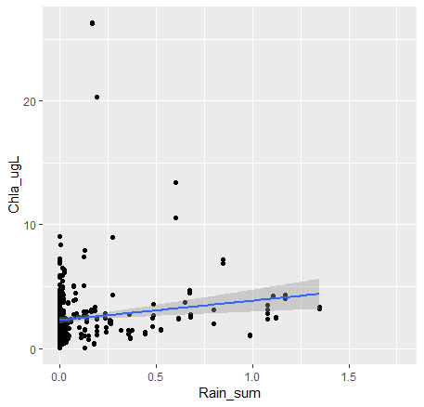
Maximum Air Temp vs FCR Surface Chla
Total Daily Rainfall vs FCR Surface Chla

Slide 2
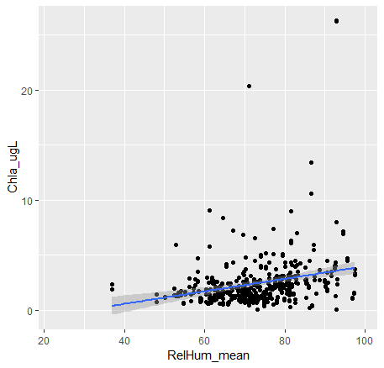
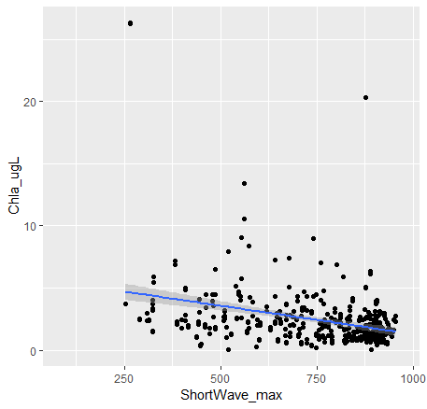
Mean Daily Relative Humidity vs. Surface Chla
Max Daily Short Wave vs. Surface Chl a

Slide 3
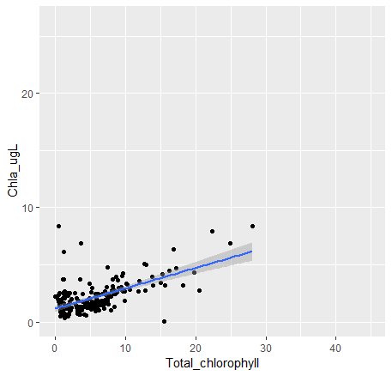

Slide 4
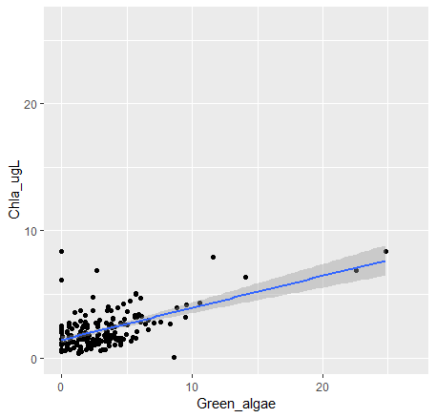
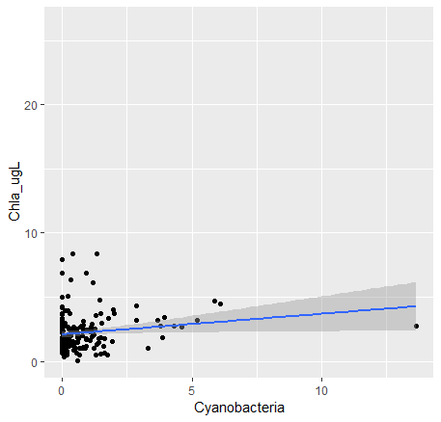
Fluoroprobe data vs. CTD Chla (surface)
More greens than cyanos

Slide 5
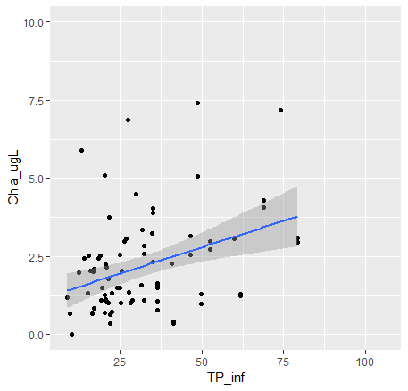
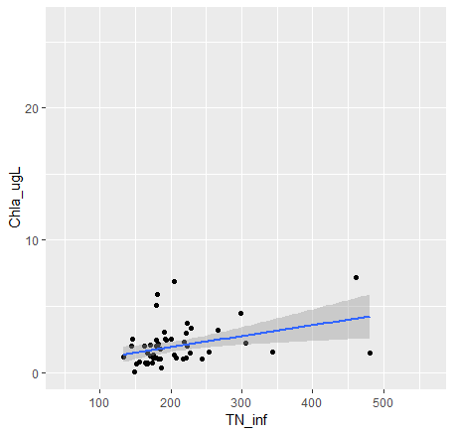
Total Phosphorous and Total Nitrogen at Inflow vs. Surface Chl a at Site 50
Notes:
-Relatively strong relationship between TP and TN at inflow and chla at 50
-look at time lags? What length?

Slide 6
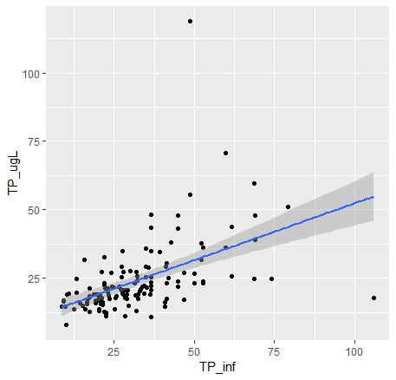
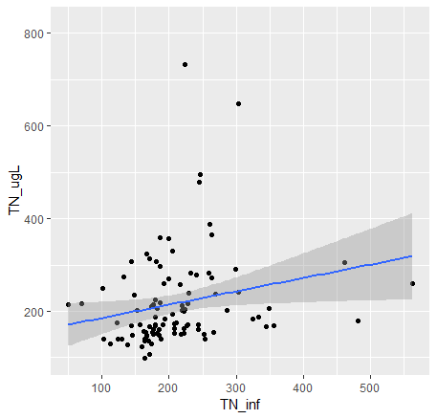
Total Phosphorus at Inflow s. Total Phosphorus at Surface, Site 50
Notes:
-TP at inf and TP at 50 are pretty strongly correlated, slightly less so with TN

Slide 7
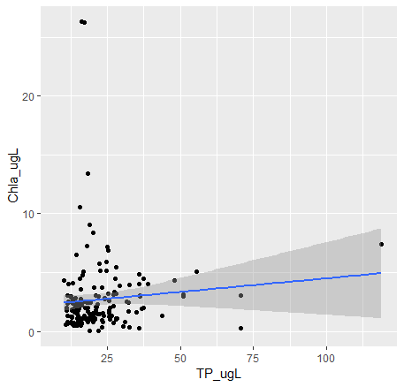
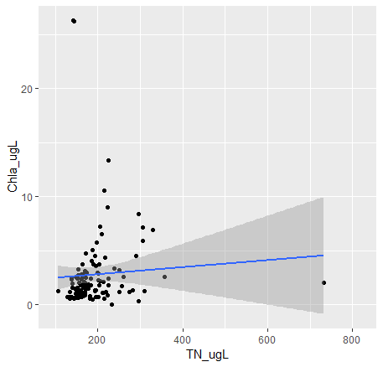
Notes:
-Not a strong relationship, because of time lags
-what length of time offset to look at? 2 weeks?

Slide 8
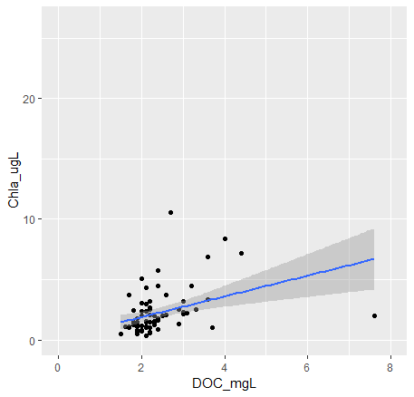
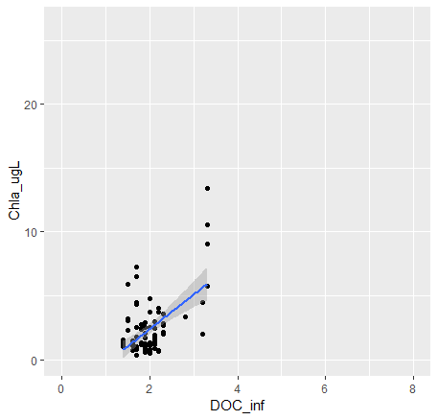
Notes:
-surprisingly strong relationship?
-

